Slide 1
Connectionist Computing
COMP 30230/41390
Gianluca Pollastri
office: CASL, ground floor Science East.
email: gianluca.pollastri@ucd.ie
Connectionist Computing COMP 30230

Slide 2



Credits
Geoffrey Hinton, University of Toronto.
  borrowed some of his slides for “Neural Networks” and “Computation in Neural Networks” courses.
Ronan Reilly, NUI Maynooth.
  slides from his CS4018.
Paolo Frasconi, University of Florence.
  slides from tutorial on Machine Learning for structured domains.
Connectionist Computing COMP 30230

Slide 3
Lecture notes on Moodle
https://csmoodle.ucd.ie/moodle/course/view.php?id=288
Strictly confidential...
Enrolment key: 30230cc
Connectionist Computing COMP 30230

Slide 4
Books
No book covers large fractions of this course.
Parts of chapters 4, 6, (7), 13 of Tom Mitchell’s “Machine Learning”
Parts of chapter V of Mackay’s “Information Theory, Inference, and Learning Algorithms”, available online at:
http://www.inference.phy.cam.ac.uk/mackay/itprnn/book.html
Chapter 20 of Russell and Norvig’s “Artificial Intelligence: A Modern Approach”, also available at:
http://aima.cs.berkeley.edu/newchap20.pdf
More materials later..
Connectionist Computing COMP 30230

Slide 5
Marking
3 landmark papers to read, and submit a 10-line summary on Moodle about: each worth 6.67%
a small connectionist tool to build and play with: 30%
Final exam: 50%
Connectionist Computing COMP 30230

Slide 6
Programming assignment
Implement a Multi-Layer Perceptron, test it.
The description on Moodle.
Submit through Moodle code and test results by April the 28th at 23:59, any time zone of your choice (Baker Island?).
30% of the overall mark
One third of a grade down every day late, that is: if you deserve an A and you’re 1 day late you get an A-, 2 days late a B+, etc.
Connectionist Computing COMP 30230

Slide 7
It depends on the problem!
Deep learning has produced some pretty stunning results in some fields (e.g. computer vision).
In other fields, going from shallow to less shallow usually helps, but there is no need (or scope) for true deep learning.
Connectionist Computing COMP 30230

Slide 8
Algorithms plus data plus CPU (or GPU) plus ease of use
Many algorithms used in deep learning have been around for a while. At most they have been combined and shuffled cleverly.
The big changes are:
  immense amounts of data
  faster computers and, especially, the ability to run training algorithms on graphics cards 1+ orders of magnitude faster, $ for $
  A number of environments/libraries that have made formerly highly complicated implementations accessible
  A LOT of buzz..
Connectionist Computing COMP 30230

Slide 9
RNNs
The idea is having discrete time steps, and considering the hidden layer at time t-1 as an input at time t.
This effectively removes cycles: we can model the network using an FFNN, and model memory explicitly.

Slide 10
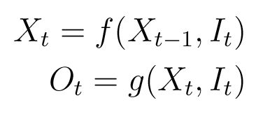
BPTT
BackPropagation Through Time.
If Ot is the output at time t, It the input at time t, and Xt the memory (hidden) at time t, we can model the dependencies as follows:

Slide 11
Ot
Xt
d
It
d = delay element

Slide 12
Ot-2
Ot-1
Ot
Ot+1
Ot+2
Xt-2
Xt-1
Xt
Xt+1
Xt+2
It-2
It-1
It
It+1
It+2

Slide 13
Past and future
RNN are OK (ish) for time dependency.
E.g. one would expect the past text to be more important than the future text to interpret language (though a little look-ahead is necessary).
But what about sequences in space?
With a time metaphor, you'll need to know the past and the future.
Connectionist Computing COMP 30230

Slide 14
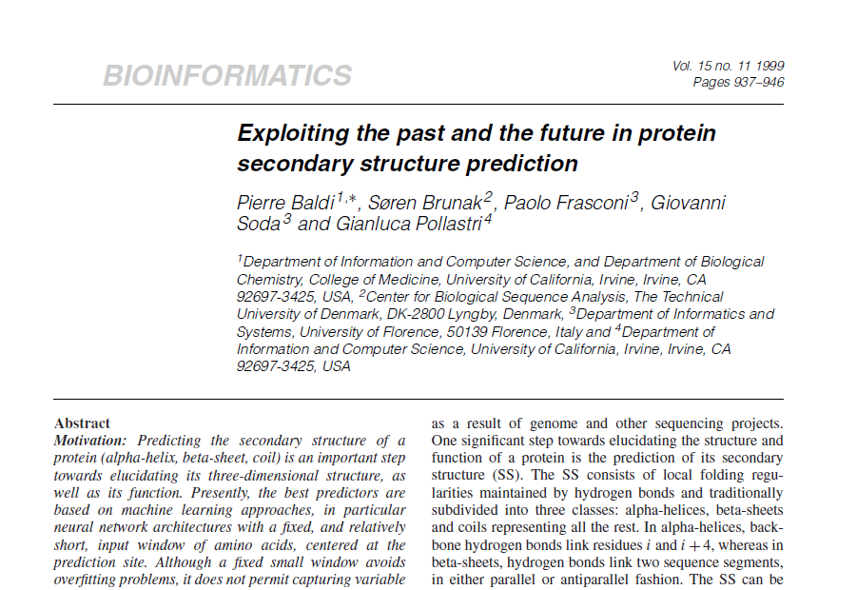

Slide 15
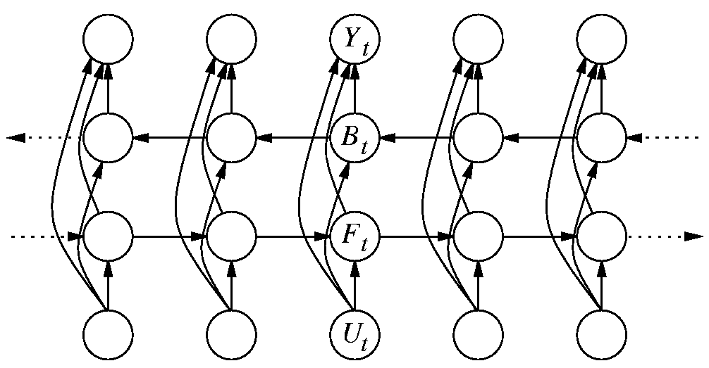
Bidirectional Recurrent Neural Networks (BRNN)

Slide 16
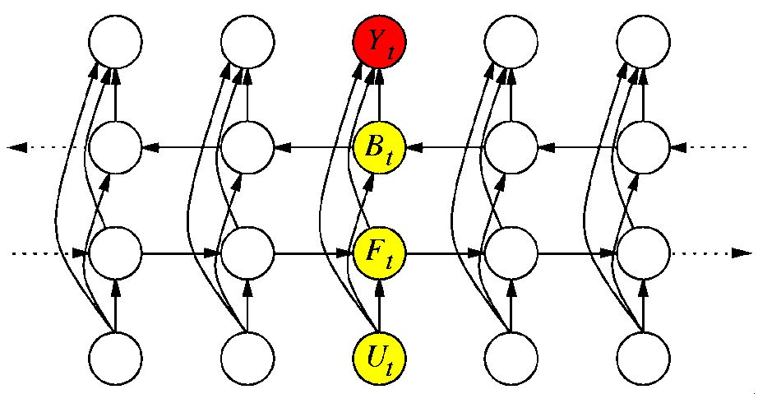
BRNN
Ft = φ( Ft-1 , Ut )
Bt = β( Bt+1 , Ut )
Yt = η( Ft , Bt , Ut )
φ() β() ed η() are realised with NN
φ(), β() and η() are independent from t: stationary

Slide 17
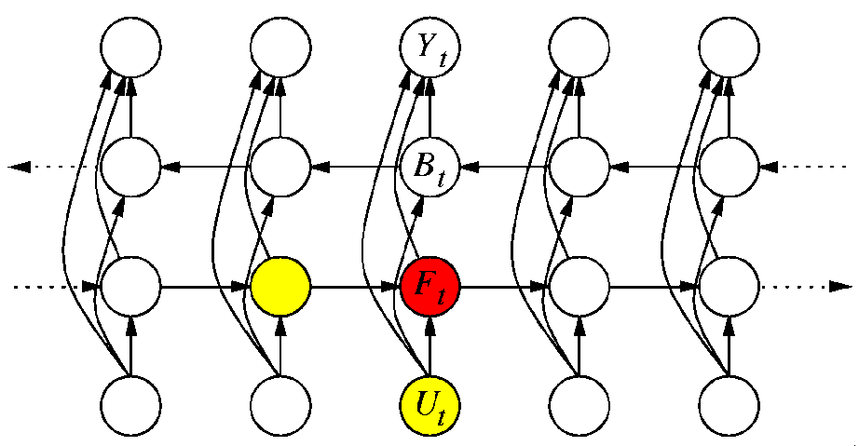
BRNN
Ft = φ( Ft-1 , Ut )
Bt = β( Bt+1 , Ut )
Yt = η( Ft , Bt , Ut )
φ() β() ed η() are realised with NN
φ(), β() and η() are independent from t: stationary

Slide 18
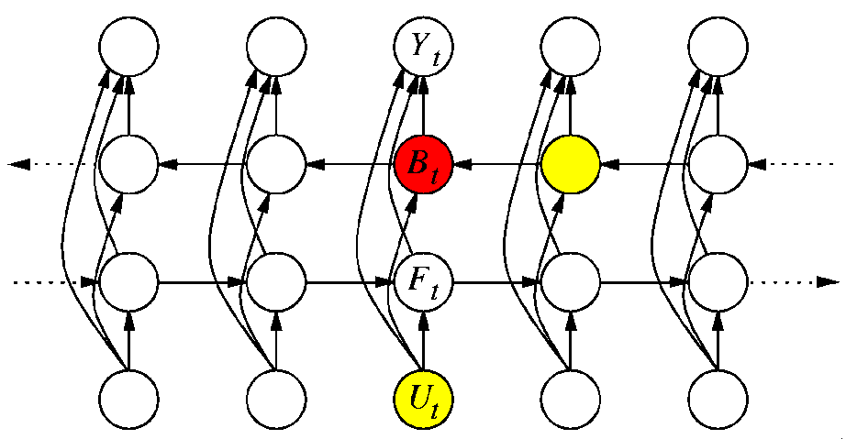
BRNN
Ft = φ( Ft-1 , Ut )
Bt = β( Bt+1 , Ut )
Yt = η( Ft , Bt , Ut )
φ() β() ed η() are realised with NN
φ(), β() and η() are independent from t: stationary

Slide 19
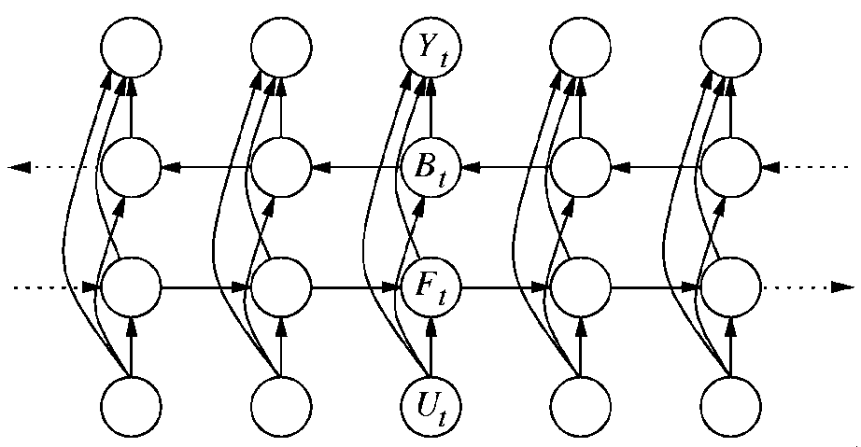
BRNN
Ft = φ( Ft-1 , Ut )
Bt = β( Bt+1 , Ut )
Yt = η( Ft , Bt , Ut )
φ() β() ed η() are realised with NN
φ(), β() and η() are independent from t: stationary

Slide 20
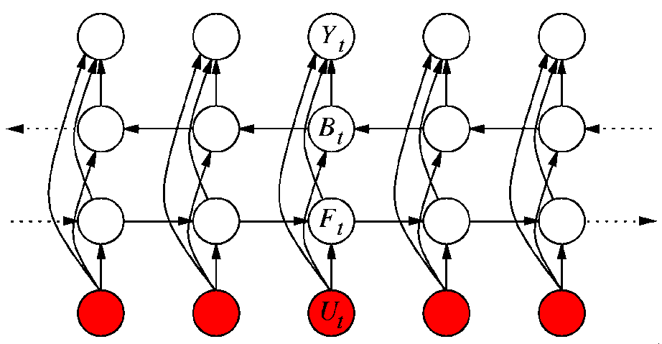
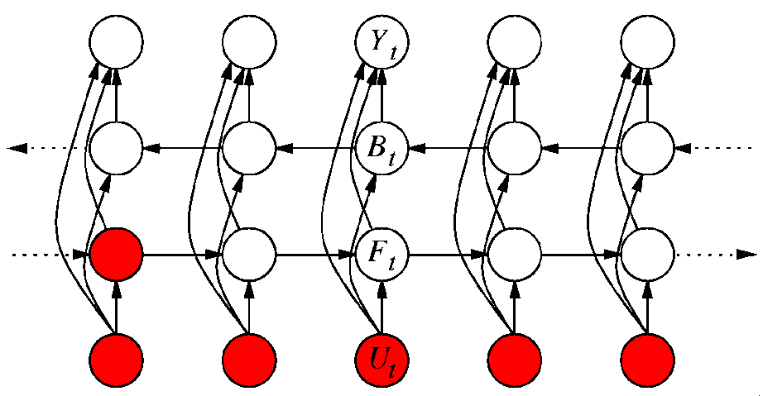
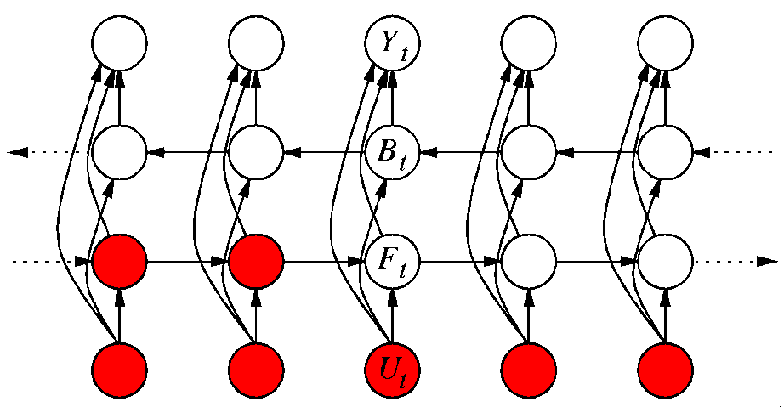
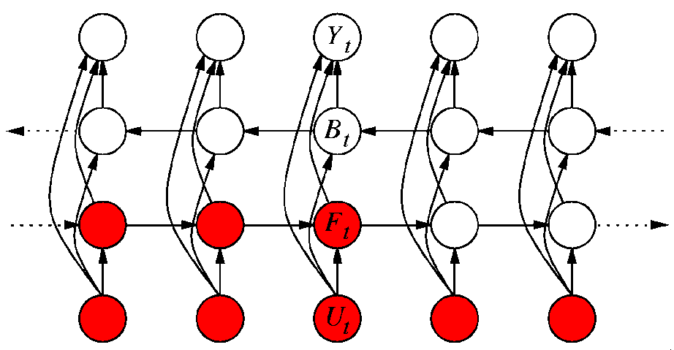
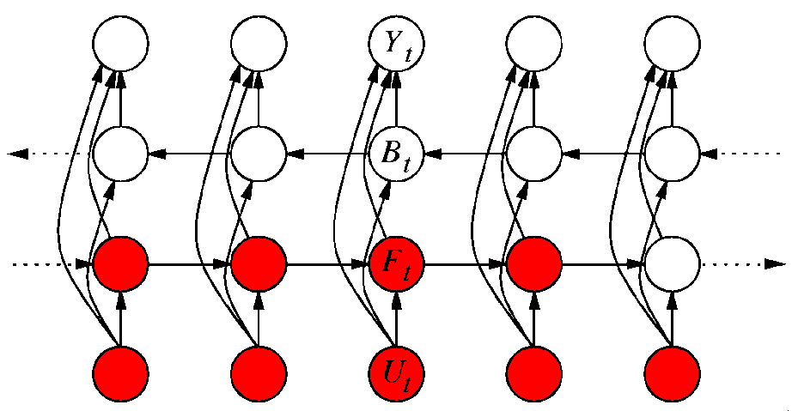
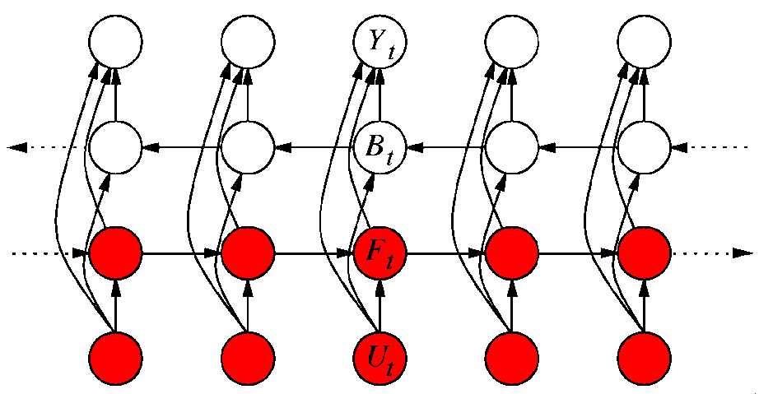
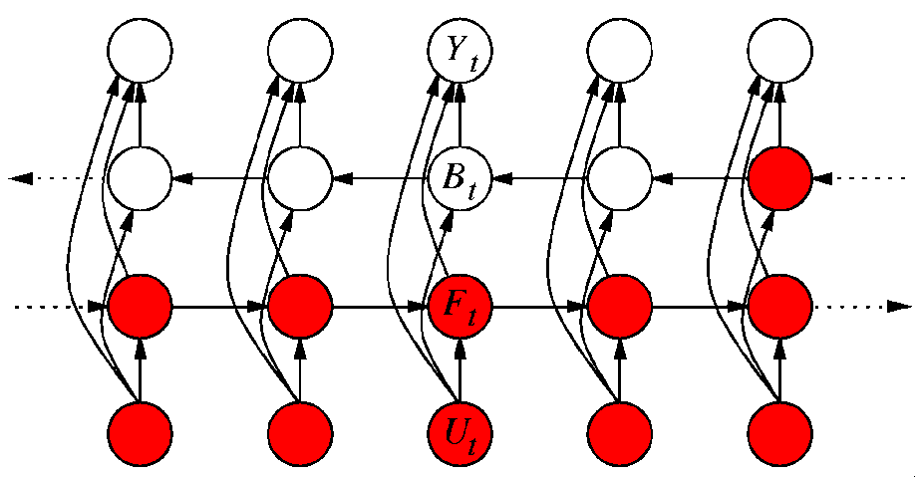
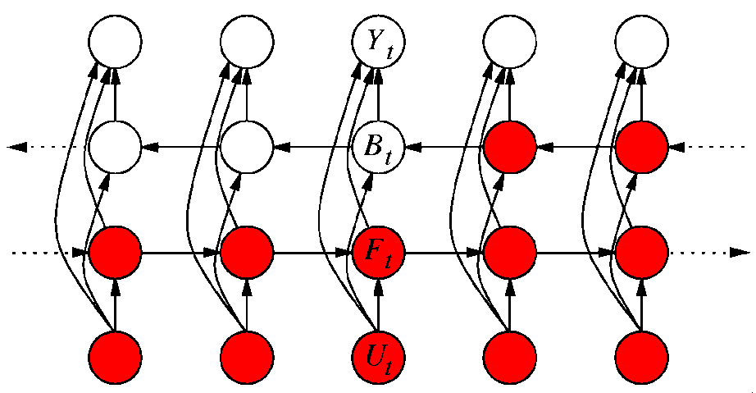
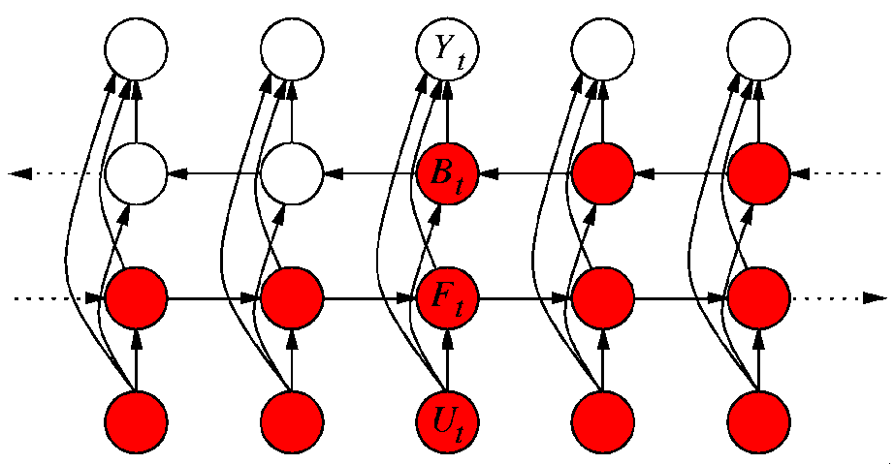
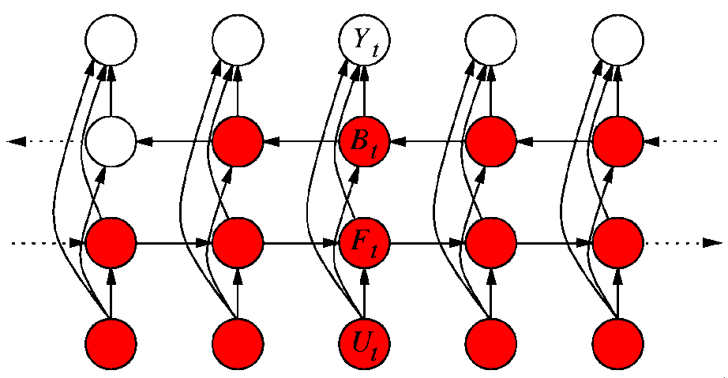
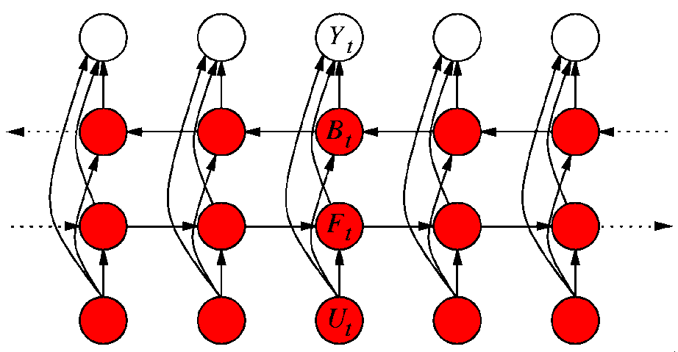
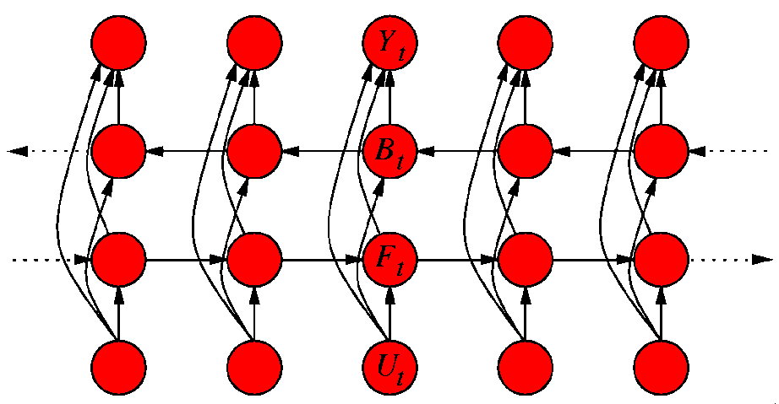
Inference in BRNNs
FORWARD(U) {
T ← size(U);
F₀ ← B_{T+1} ← 0;
for t ← 1..T
F_{t} = φ( F_{t-1} , U_{t} );
for t ← T..1
B_{t} = β( B_{t+1} , U_{t} );
for t ← 1..T
Y_{t} = η( F_{t} , B_{t} , U_{t} );
return Y;
}

Slide 21
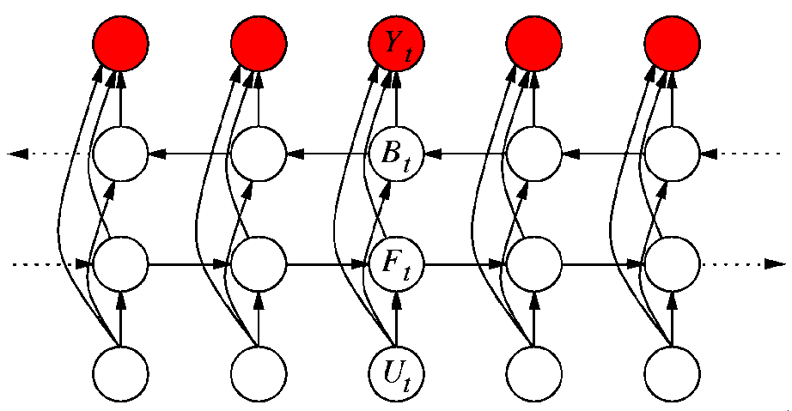
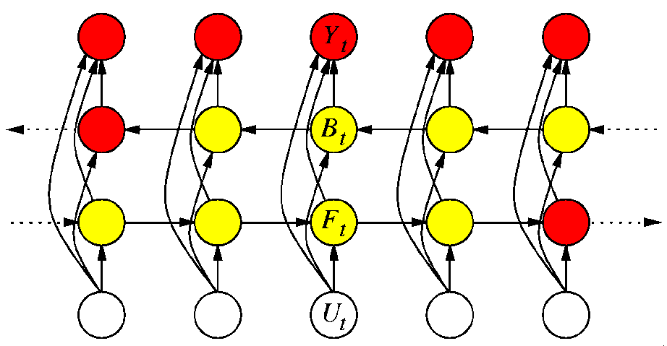
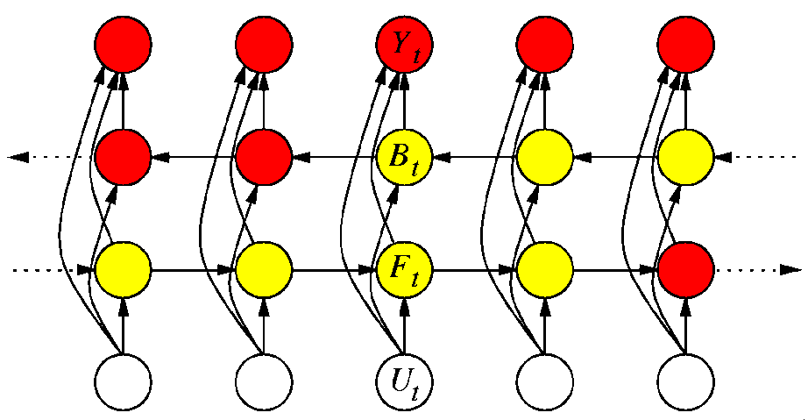
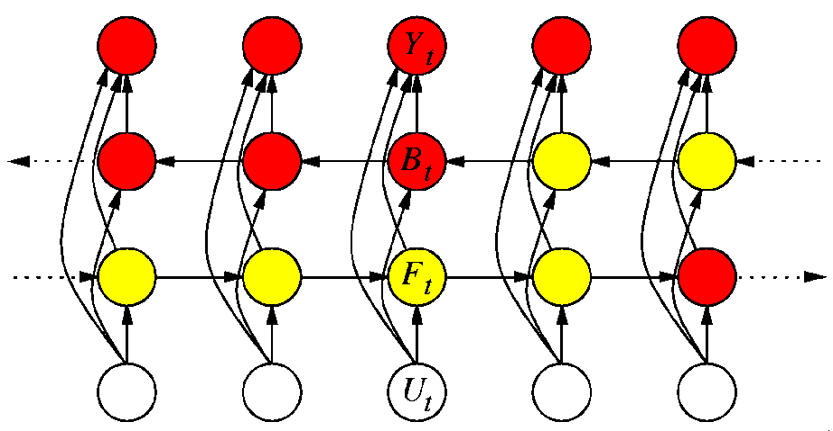
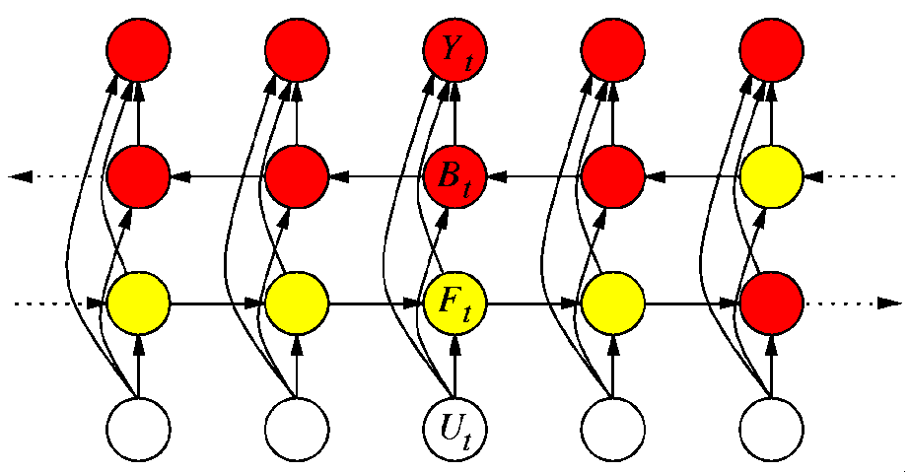
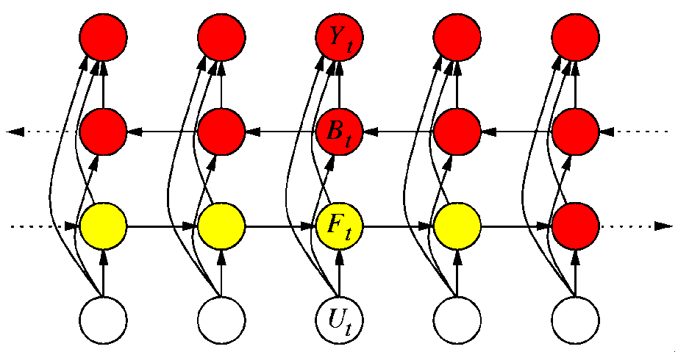
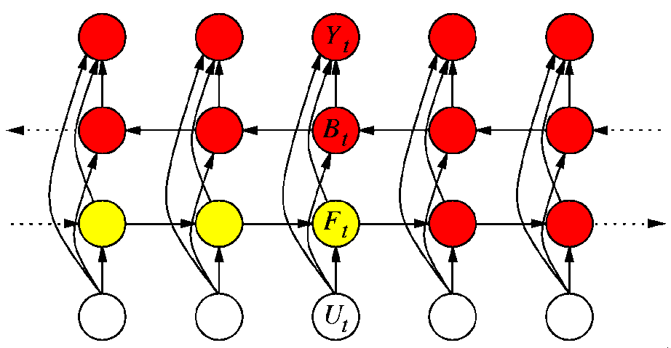
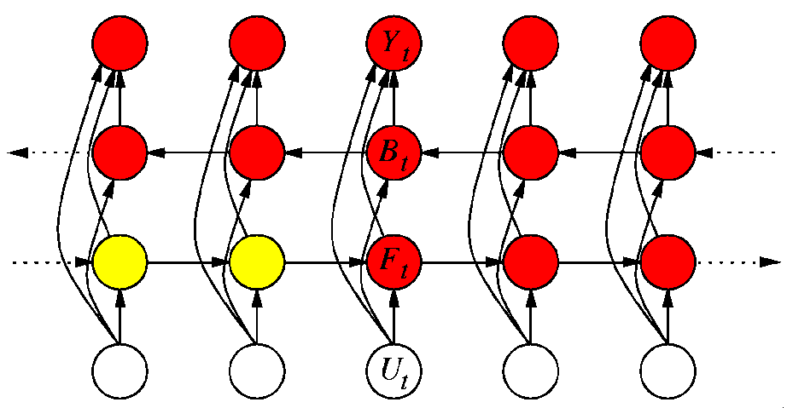
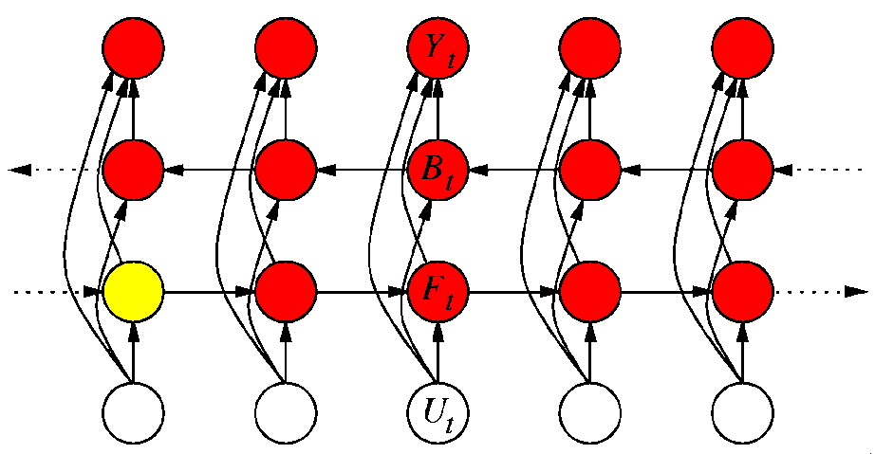
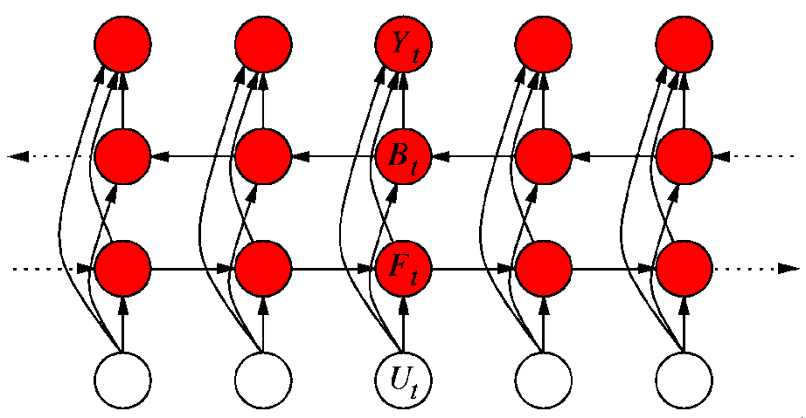
Learning in BRNNs
GRADIENT(U,Y) {
T ← size(U);
F₀ ← B_{T+1} ← 0;
for t ← 1..T
F_{t} = φ( F_{t-1} , U_{t} );
for t ← T..1
B_{t} = β( B_{t+1} , U_{t} );
for t ← 1..T {
Y_{t} = η( F_{t} , B_{t} , U_{t} );
[δF_{t}, δB_{t}] = η.backprop&gradient( Y_{t} - Y_{t} );
}
for t ← T..1
δF_{t-1} += φ.backprop&gradient(δF_{t} );
for t ← 1..T
δB_{t+1} += β.backprop&gradient(δB_{t} );
}

Slide 22
What's good with BRNN
They find the ideal "window size" by themselves. In theory they see the whole input.
They are DEEP (or, most paths are). Which means they are clever.
They have proven to be one of the best models for processing biological sequences.
Connectionist Computing COMP 30230

Slide 23
Once started..
Sequences are dealt with.
But structured problems do not stop there.
In general one would like to be able to deal with graphs of any type (even undirected ones containing cycles).
Sequences are 1D entities. But what about 2D? E.g. images?
Connectionist Computing COMP 30230

Slide 24
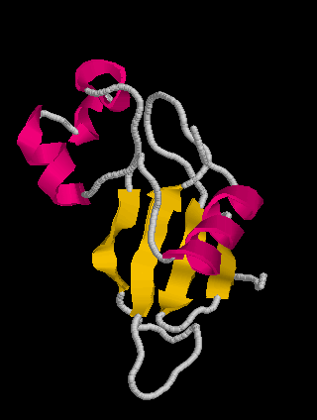
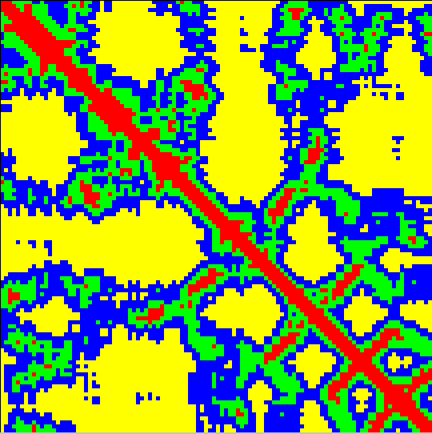
Example: Distance maps
3D Multi Map

Slide 25
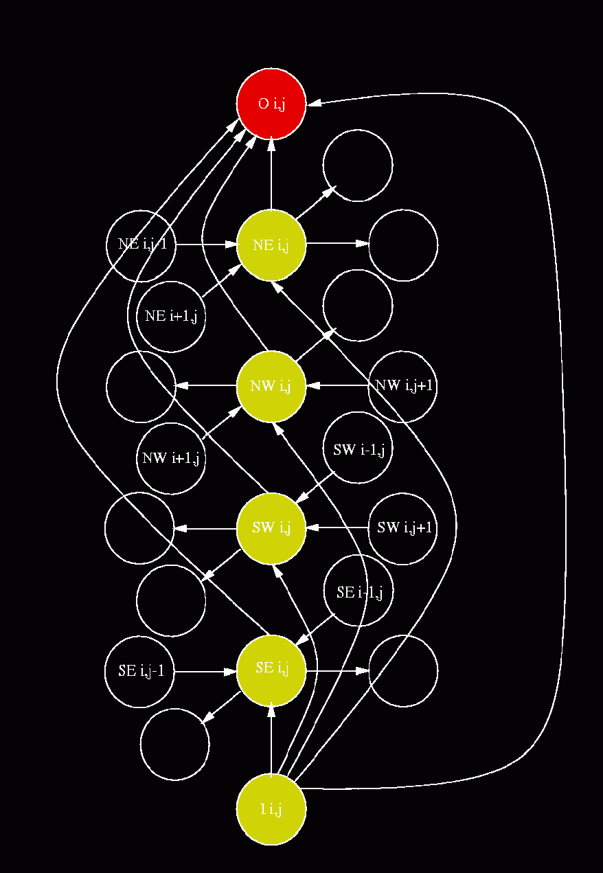
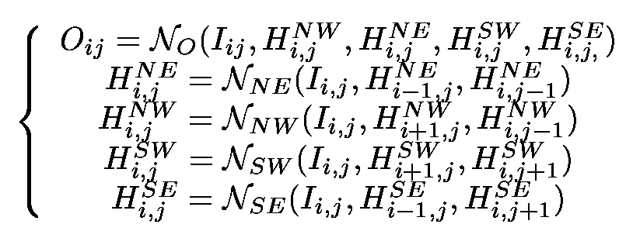
2D RNNs
Pollastri & Baldi 2002, Bioinformatics
Baldi & Pollastri 2003, JMLR

Slide 26
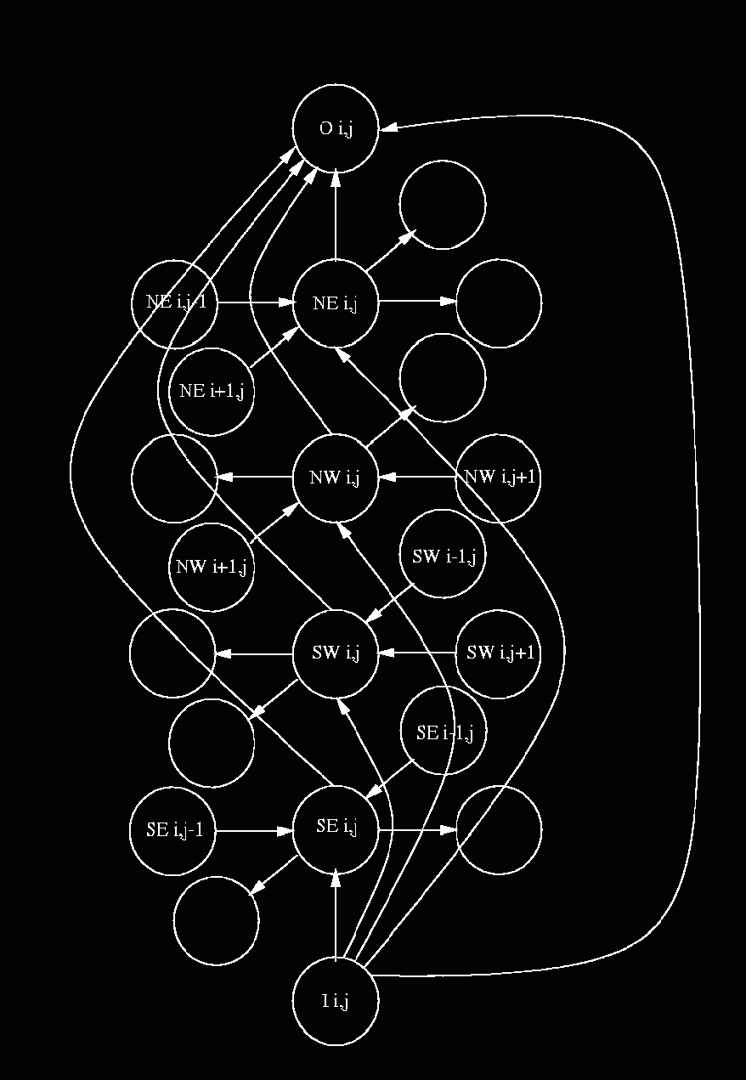
2D RNNs

Slide 27
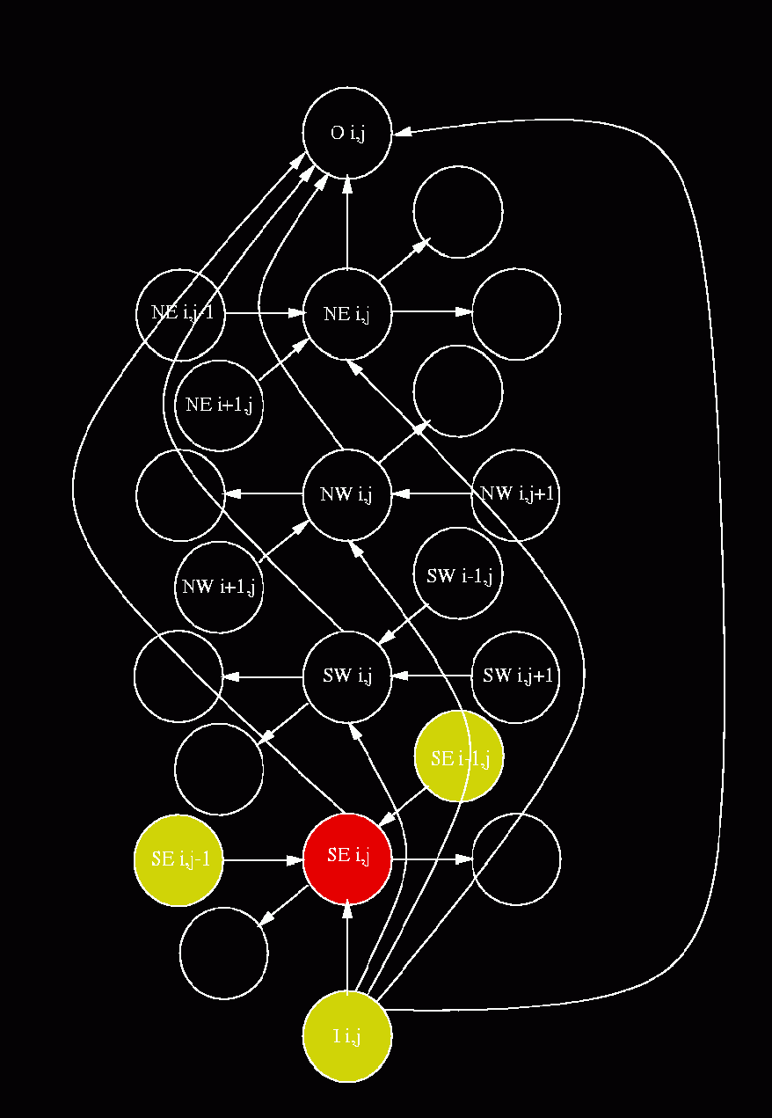
2D RNNs

Slide 28
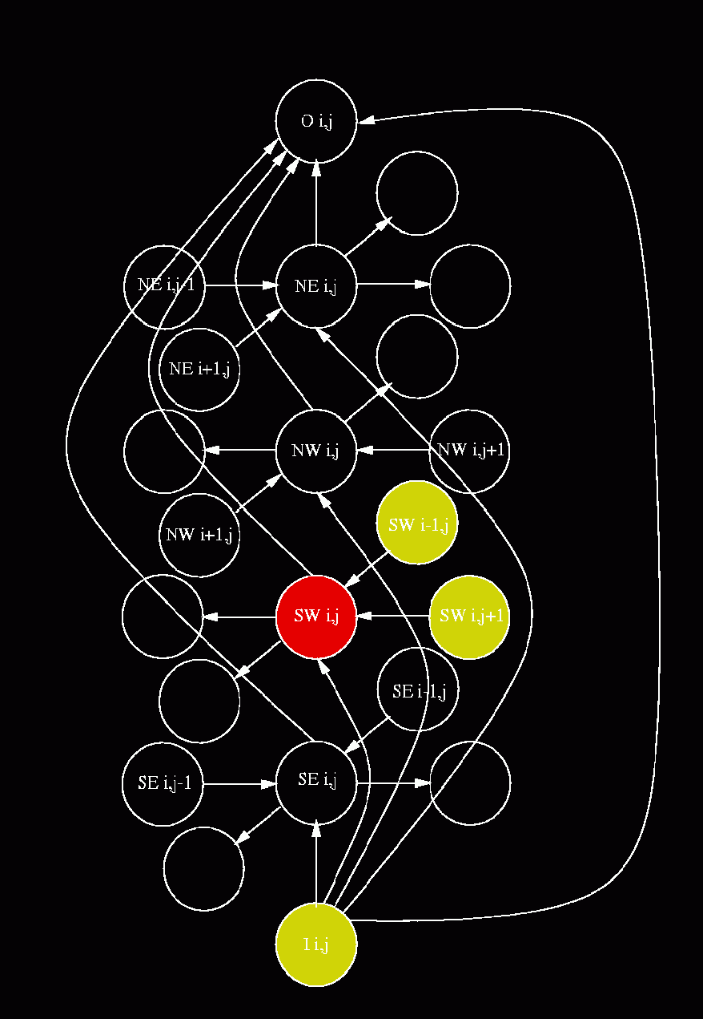
2D RNNs

Slide 29
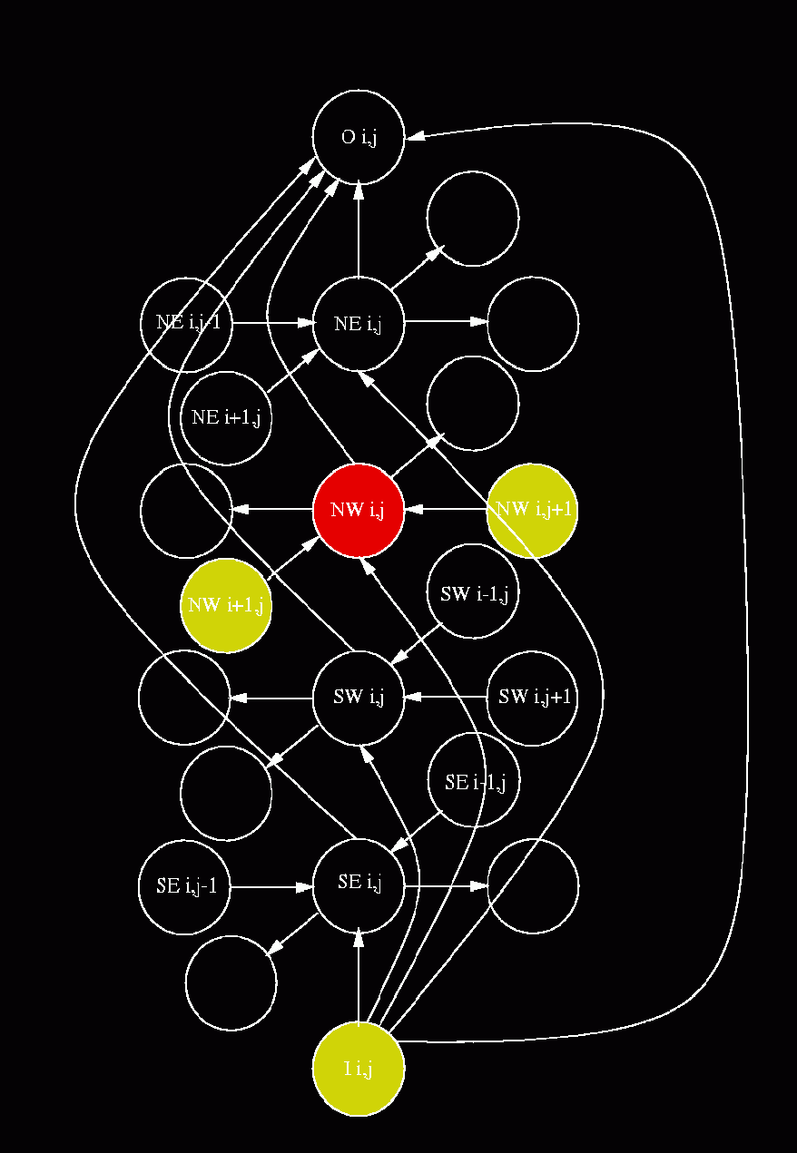
2D RNNs

Slide 30
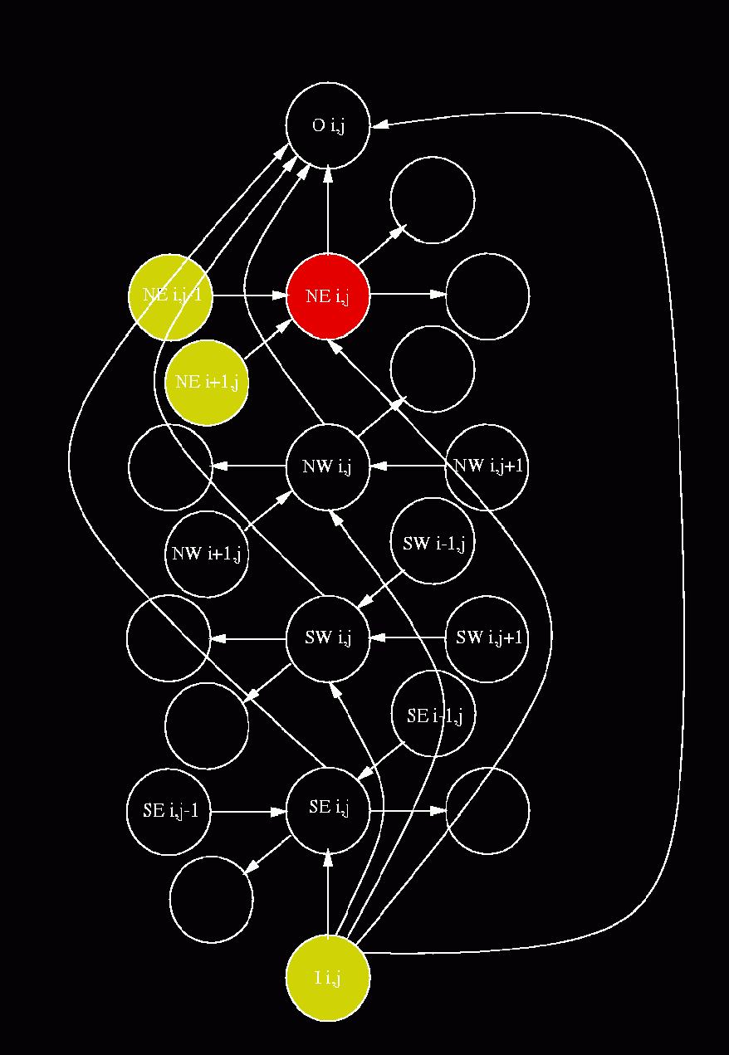
2D RNNs

Slide 31
2D RNNs

Slide 32
2D-RNNs
Excellent model, very DEEP!
Top results where applied.
Finds incredibly long-ranged dependencies.
Connectionist Computing COMP 30230

Slide 33

Complexity?
A 2D-RNN contains 5xNxN individual neural networks.
For a 1024x1024 pixel image that is 5+ million nets.
Most synapses are shared, so there isn't an overfitting problem.
But it's tens of billions of weights to train.
Months of 1-core training, in some cases.

Slide 34
N-to-1
RPYACPVESCDRRFSQSGSLTRHIRIHTGQKPFQCRICMRNFSRSDHLTTHIRTHTGEKPFACDICGRK
Red/green/blue
Notice: N is variable, which is a problem..

Slide 35
Composition vs. sequence
A simple solution would be to look at the frequencies of letters (composition).
All positional information is lost!
Same composition:
AAAAAAAAAACCCCVVVVVVVVVV
AVAVCVAAVCVAAVCVAAVCVAVA
And we know that motifs are important in most interesting problems.

Slide 36
Motifs are hard to deal with
Can’t compute stats for all motifs of n letters: there are 20^{n} of them, and only hundreds of examples.
Tried before. It didn't work even on motifs of 2 or 3 letters, unless one has millions of examples.

Slide 37
Compress!
We need to compress the representation:
Create a bottleneck: represent zillions of different motifs with only hundreds of parameters.
And we need to do this with an N to 1 wiring.

Slide 38
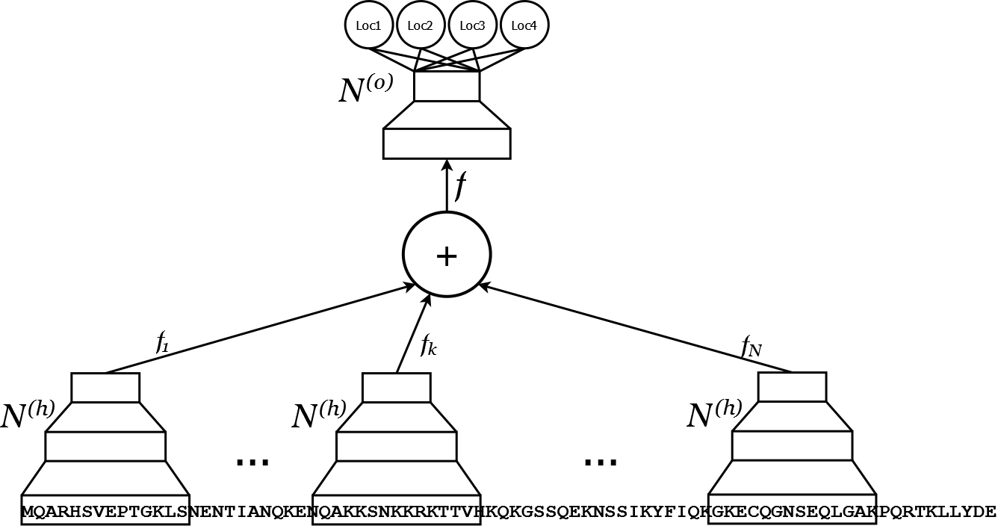
N to 1 Neural Networks
Mooney, Wang & Pollastri, Bioinformatics, 2011

Slide 39
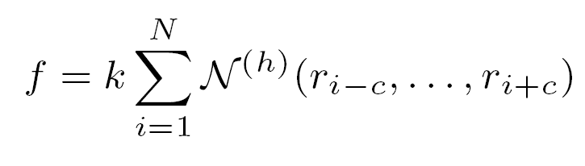
N-to-1 by neural networks
Map W=2c+1 letters into a hidden vector f.
Use the same function (network) for each of the N windows in a sequence.
Now we have N hidden vectors.
Just add them up!

Slide 40
N-to-1 neural networks (2)
f is a vector which contains information about all 2c+1-substrings in a sequence. Say c=7 (15 letters).
Say |f|=3 : ~1000 parameters in total to represent a monster space.
(The trick is that we repeat the same net)

Slide 41
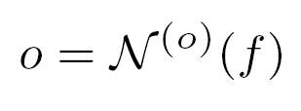
N-to-1 neural networks (3)
Map f into output: another net. Now we have a full input-output (N to 1) map

Slide 42
N-to-1 neural networks (4)
Training: this is a trivial feed-forward Neural Network (with many shared weights) –backpropagation.

Slide 43
N-to-1 neural networks (5)
So, we don't need to worry about how to figure f out.
Backpropagation will find a suitable transform to generate f for us.

Slide 44
f
Vector f is a property-driven, adaptive compression of the whole sequence: fixed size!
What does it tell us about whatever sequences we are dealing with?
Can we explore/map the space of sequences by looking at their f?

Slide 45
N-to-1 NN results
Best systems in the world for protein subcellular localisation prediction.
Spare capacity. As sets grow bigger, it may do better and better.

